Slide 1
Trees + Recursion Review Session
CS61A • Spring 2018 • Karina & Dennis
Notes:
Recursion, trees, tree recusion

Slide 2
Recursion

Slide 3
Recursion...
… when you call a function from inside itself!
What could possibly go wrong?
>>> def recursion(recurse): ... return recursion(recurse)
Notes:
Dennis
I think we are all pretty familiar with recursion now, sum up in a single sentence
A function that calls itself, slowly solving smaller and smaller subproblems, until we hit a base case
Returning from the base case, we can combine our recursive calls at each step and get the final answer

Slide 4
Recursion...
… when you call a function from inside itself!
What could possibly go wrong?
>>> def recursion(recurse): ... return recursion(recurse)
Two parts of recursion
Base case
Recursive leap of faith
Notes:
Dennis
2 parts of recursion
Whenever, we do recursion, we MUST have a base case whenever we do recursion, so that we stop somewhere
Recursive leap of faith is name dropped a lot, it very simply means while we write our recursive function, we can use our function and rely on the fact (believe!) that it returns what it’s supposed to
Just remember these two parts of recursion, sometimes it may be easier to come up with how you will use the recursion, other times it may be easier to try and think of what the base case is, which will help you figure out the recursion
What are the disadvantages of recursive programming over iterative programming?
Note that both recursive and iterative programs have same problem solving powers, i.e., every recursive program can be written iteratively and vice versa is also true. Recursive program has greater space requirements than iterative program as all functions will remain in stack until base case is reached. It also has greater time requirements because of function calls and return overhead.

Slide 5
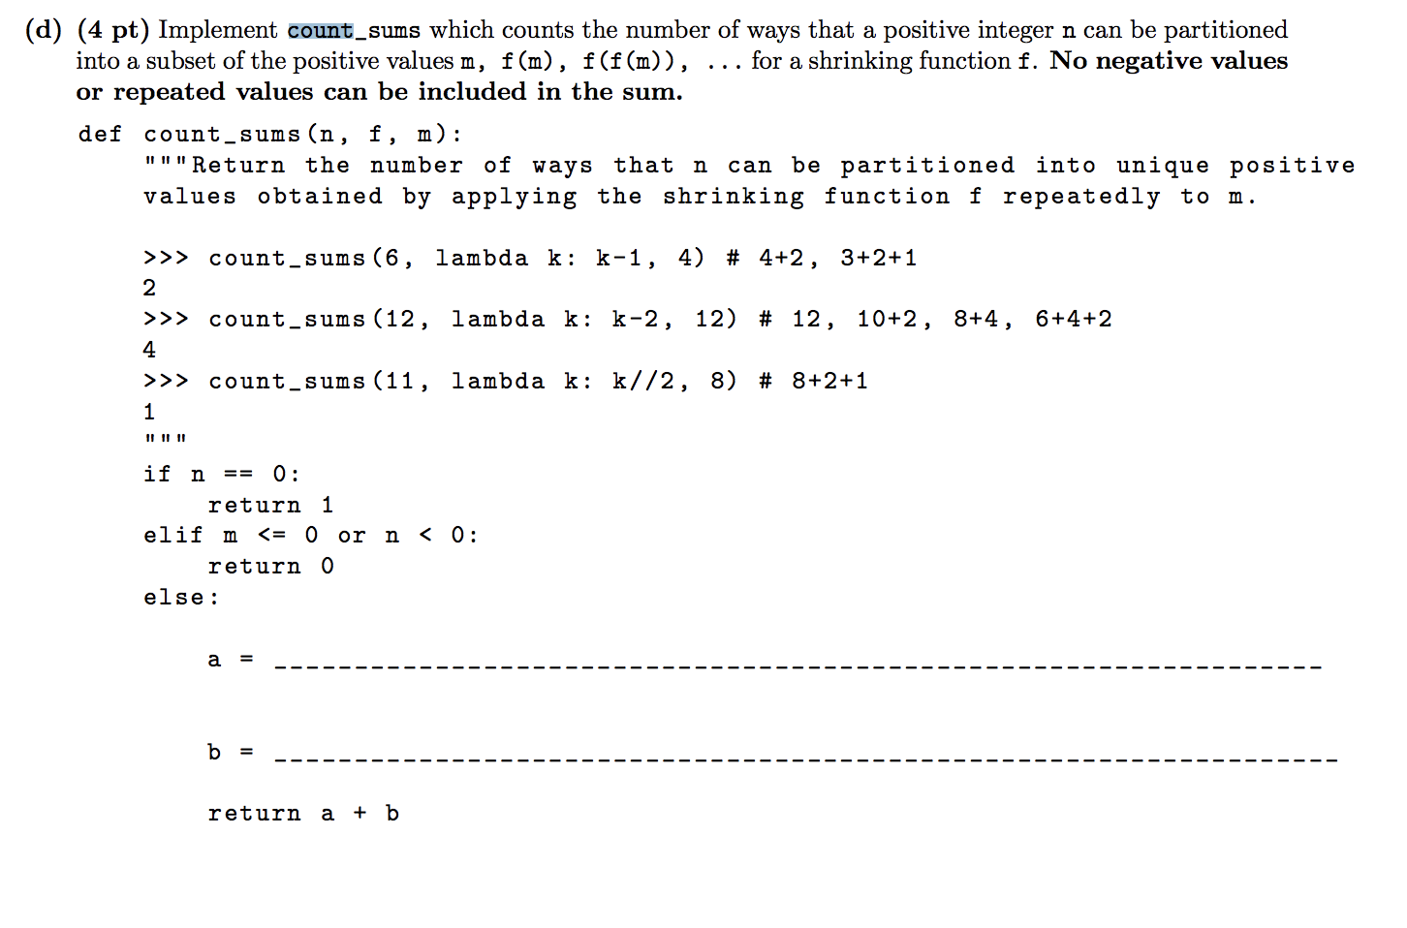
Notes:
Dennis
Very similar to some problem we have seen before!

Slide 6
count_sums (n -m , f , f ( m ))
count_sums (n , f , f ( m ))
Notes:
Dennis
Very similar to count change
The key idea of count_partitions/count_change, is to have a Tree of decisions
In terms of count change, we have a variable n that represents our money, m to be the current size coin we have selected. Here we have f to “decrement” the size of coin we’re using
When we run out of money exactly, we count the decisions (the coins we have chosen leading up now) as valid. Else if we run out of coins or if we get negative money, we terminate

Slide 7
Trees

Slide 8
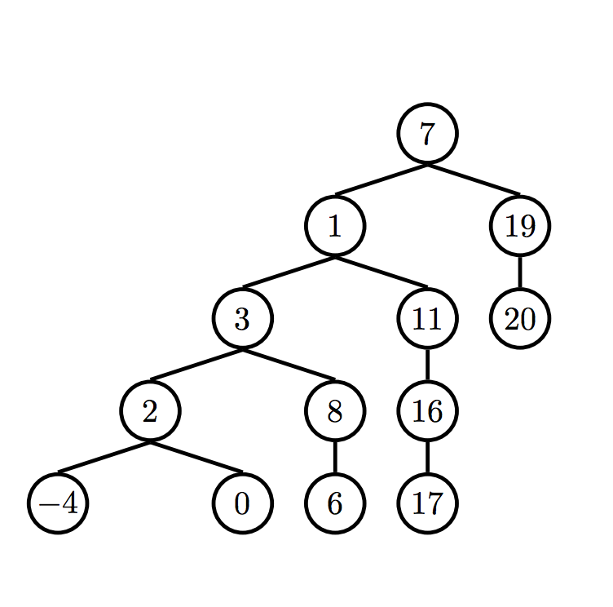
Terminology
branches down; root is at top and leaves are at bottom
parent node: node w/branches
can have multiple branches
branches: the subtree that extends from the branch node
branch node: node w/a parent
previously known as “child”
each “child”/branch node can only have one parent
root: v top of ur tree
label: value inside of the node
leaf: node w/no branches
Slides thanks to Annie :`)

Slide 9
Terminology
depth: # of edges from root of tree to the node
think: how many edges in the path from root -> node X?
height: depth of the furthest/lowest leaf
aka, maximum depth in the tree!
Slides thanks to Annie :`)

Slide 10
Trees are an Abstract Data Type
(a Concept™ that you choose the implementation for)
Notes:
the things we just talked about (terminology) composes what makes up of this conception/idea of a “Tree” structure
all Trees just need to have those components, and those properties, in order for it to be considered a “Tree”
related to the lab you just did — “replace_elem”
how you actually want to represent that Tree in code, is left to the programmer
later in the semester we’ll be representing Trees using objects!
but now we’ll be using lists
v important to abstract away the details

Slide 11
Implementation
ABSTRACTION!!
Constructors
how would you create a tree, using only the knowledge/information of what a tree contains? (labels & branches)
think of the domain (input) and abstracted range (expected output)
def tree(label, branches=[]): # returns a Tree of some form
Slides thanks to Annie :`)

Slide 12
Implementation
ABSTRACTION!!
Selectors
how do you grab/extract information from this ~tree~ you’ve just created, without knowing the implementation details?
def label(tree): # returns the label of your root node in the Tree def branches(tree): # returns the branches in your Tree def is_leaf(tree): # tells you if a node is a leaf or not
Slides thanks to Annie :`)

Slide 13
Practice Time

Slide 14
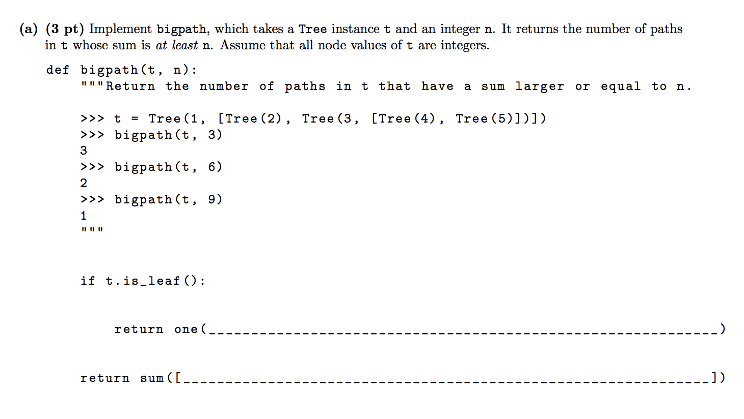
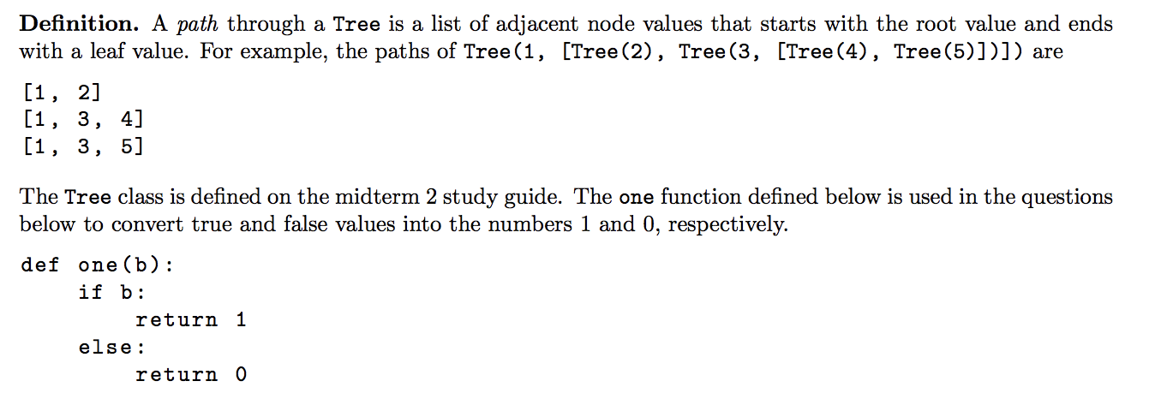
Definition. A path through a Tree is a list of adjacent node values that starts with the root value and ends with a leaf value.
Notes:
Dennis
Basically: A path is a journey from the root to a leaf
You may find the one function useful, it takes some variable, returns 1 if its truthy, else zero

Slide 15
Definition. A path through a Tree is a list of adjacent node values that starts with the root value and ends with a leaf value.
one ( t.label >= n )
sum ([bigpath(b , n - t.label) for b in t.branches ])
Notes:
Dennis
We keep subracting from n as we do our recursive calls
When we reach a leaf value, we just check if the the last label is greater than the amount we have left
We sum all the recursive calls (1 for each success) to get the number of paths that end with a sum >= n

Slide 16
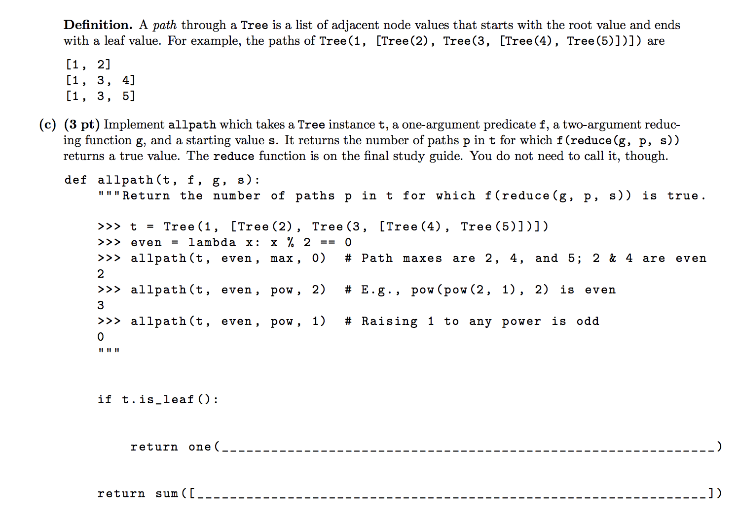
Definition. A path through a Tree is a list of adjacent node values that starts with the root value and ends with a leaf value.

Slide 17
one ( f ( g (s , t.label )))
sum ([ allpath (b , f , g , g (s , t.label )) for b in t.branches ])
Notes:
Figure out what each of the arguments are
Read through the docstrings
Think about how can you use the list comp to identify patterns and maximize partial credit

Slide 18
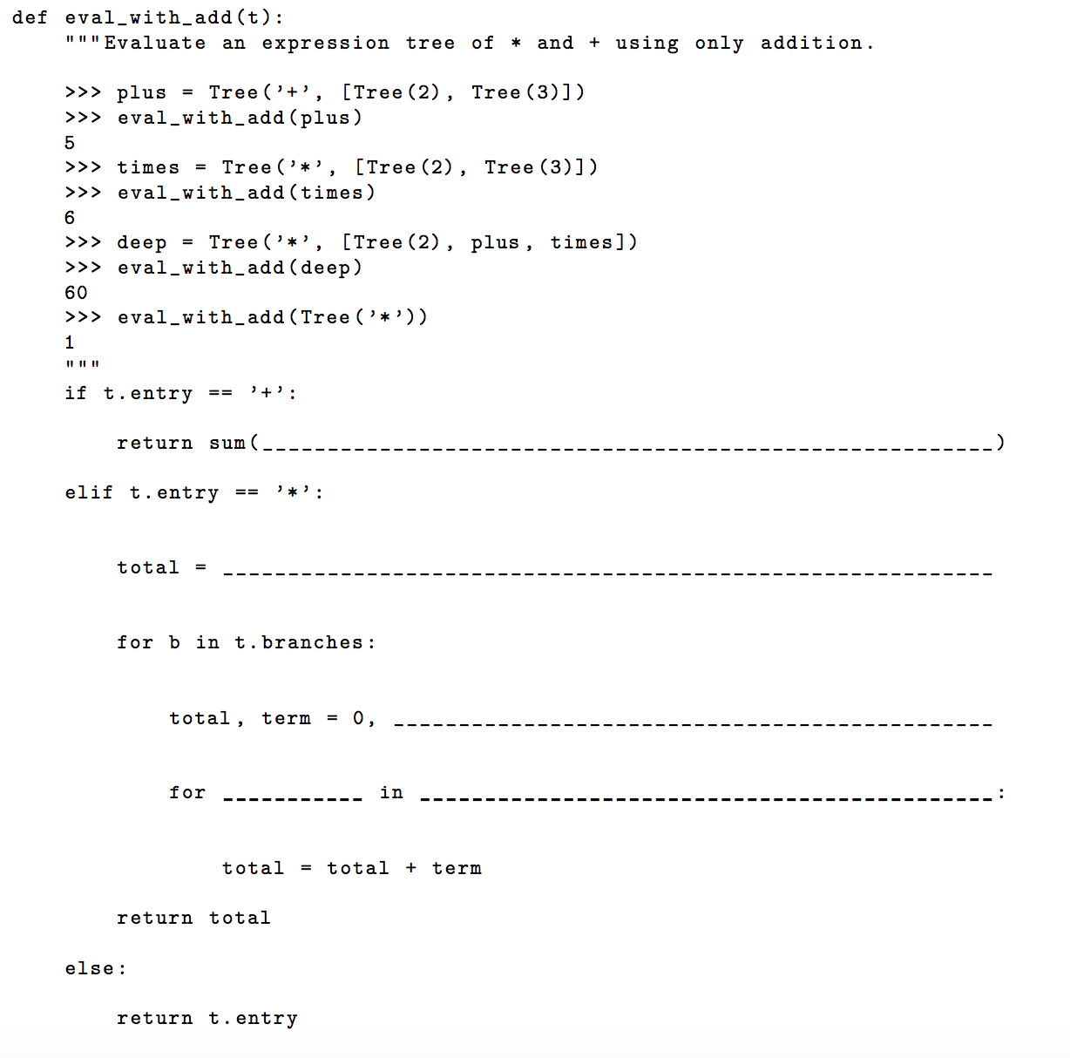
Unfortunately, multiplication in Python is broken on your computer. Implement eval_with_add, which evaluates an expression without using multiplication. You may fill the blanks with names or call expressions, but the only way you are allowed to combine two numbers is using addition.
Notes:
Dennis
Scheme flashbacks, trees represent expressions
We have 2 possible operations, addition and multiplication
The plus and asterisk symbol as a root value denote if we want to add or mul subtrees

Slide 19
Unfortunately, multiplication in Python is broken on your computer. Implement eval_with_add, which evaluates an expression without using multiplication. You may fill the blanks with names or call expressions, but the only way you are allowed to combine two numbers is using addition.
sum ([ eval_with_add(b) for b in t . branches ])
1
total
_
range ( eval_with_add (b)):
Notes:
Dennis
“Eval operator, eval operations, apply”
We figure out of its + or *.
If + We call eval on the subtrees (representing the things we want to add together), then sum
If *, we keep a running total. Go to each branch, call eval on it, then multiply the resulting value into our total

Slide 20
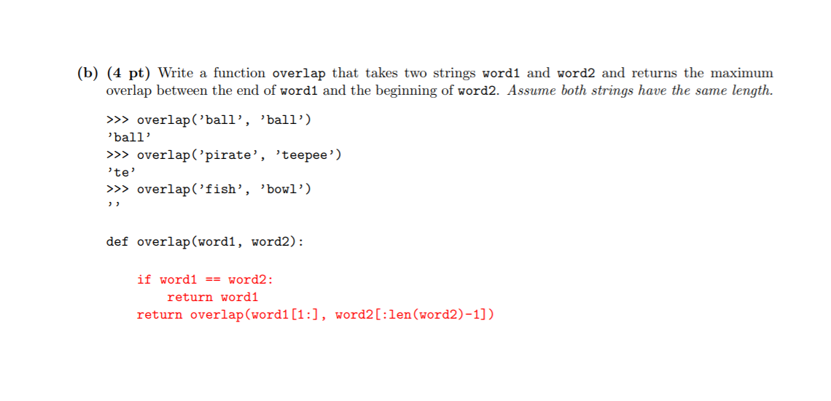

Slide 22
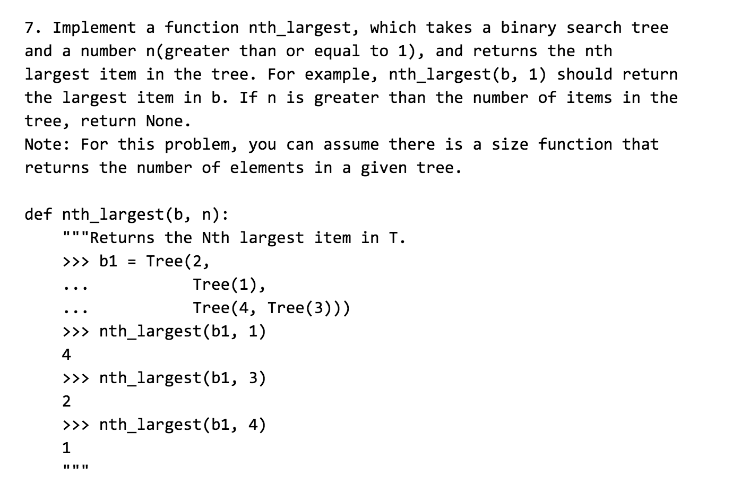
Notes:
Dennis
Bst, the tree denoted by b.right, has a greater root value than this one
The tree by b.left has a lesser root value
And so on
Find the nth largest number
Think about using the size function, returning the number of nodes in some tree

Slide 23
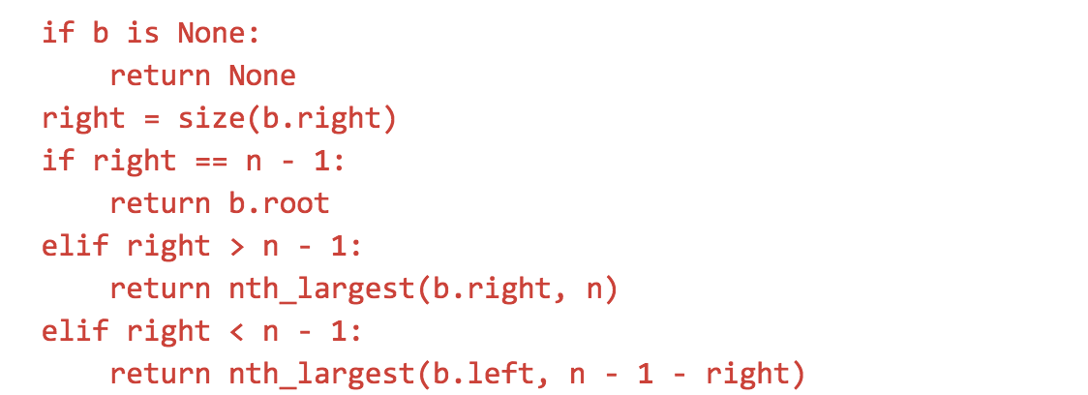
Notes:
Dennis
We have a number of cases
If we end up trying to recursive call on a tree that doesnt exist, we didn’t end up finding the nth biggest item
We get the number of items in the tree that are bigger than us with size
Everything in the right subtree is bigger than b.label (or b.root)!
If the exactly n-1 numbers bigger than us, return answer
More than n-1 numbers bigger than us, the nth biggest number must be somewhere in the right tree
Less than n-1 numbers bigger than us, the nth biggest number must be somewhere to our left
Subtract the number of nodes that are larger than us.
If we don’t we will end up searching for the 2*nth largest number! We need to search the (n-right) th number in the left subtree.
Didnt have to do this in the first case, since there are greater than n numbers larger than us (nothings changed)

